Slide 1
File System Implementation
Ms. Manya Gidwani

Slide 2
File System Implementation
A file is a collection of related information.
The file system resides on secondary storage and provides efficient and convenient access to the disk by allowing data to be stored, located, and retrieved.
File system organized in many layers :

Slide 3
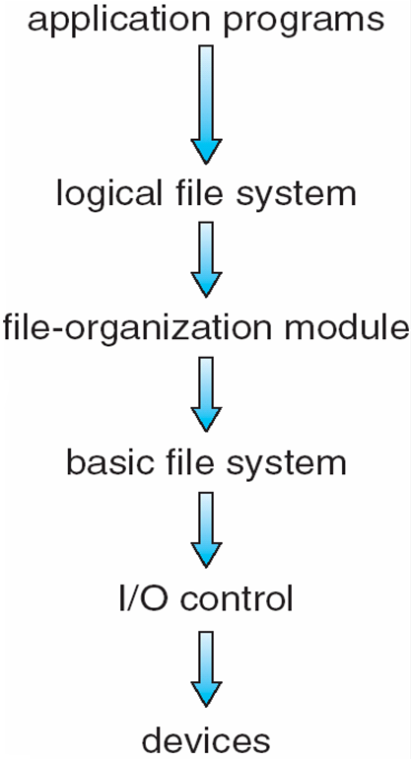
Layered File System

Slide 4
I/O Control level – Device drivers acts as interface between devices and Os, they help to transfer data between disk and main memory. It takes block number a input and as output it gives low level hardware specific instruction.
Basic file system – It Issues general commands to device driver to read and write physical blocks on disk.It manages the memory buffers and caches. A block in buffer can hold the contents of the disk block and cache stores frequently used file system metadata.
File organization Module – It has information about files, location of files and their logical and physical blocks.Physical blocks do not match with logical numbers of logical block numbered from 0 to N. It also has a free space which tracks unallocated blocks.
Logical file system – It manages metadata information about a file i.e includes all details about a file except the actual contents of file. It also maintains via file control blocks. File control block (FCB) has information about a file – owner, size, permissions, location of file contents.

Slide 5
We can implement file system by using two types data structures :
1. On-disk Structures – Generally they contain information about total number of disk blocks, free disk blocks, location of them and etc. Below given are different on-disk structures :
Boot Control Block – It is usually the first block of volume and it contains information needed to boot an operating system.In UNIX it is called boot block and in NTFS it is called as partition boot sector.
Volume Control Block – It has information about a particular partition ex:- free block count, block size and block pointers etc.In UNIX it is called super block and in NTFS it is stored in master file table.
Directory Structure – They store file names and associated inode numbers.In UNIX, includes file names and associated file names and in NTFS, it is stored in master file table.
Per-File FCB – It contains details about files and it has a unique identifier number to allow association with directory entry. In NTFS it is stored in master file table.

Slide 6
2. In-Memory Structure : They are maintained in main-memory and these are helpful for file system management for caching. Several in-memory structures given below :
Mount Table – It contains information about each mounted volume.
Directory-Structure cache – This cache holds the directory information of recently accessed directories.
System wide open-file table – It contains the copy of FCB of each open file.
Per-process open-file table – It contains information opened by that particular process and it maps with appropriate system wide open-file.

Slide 7
File Allocation
Disks are divided into physical blocks (sectors on a track)
Files are divided into logical blocks (subdivisions of the file)
Logical block size = some multiple of a physical block size
The operating system or file management system is responsible for allocating blocks to files
Space is allocated to a file as one or more portions (contiguous set of allocated disk blocks). A portion is the logical block size
File allocation table (FAT)
data structure used to keep track of the portions assigned to a file
Notes:
On secondary storage, a file consists of a collection of blocks. The operating system
or file management system is responsible for allocating blocks to files. This raises
two management issues. First, space on secondary storage must be allocated to files,
and second, it is necessary to keep track of the space available for allocation. We
will see that these two tasks are related; that is, the approach taken for file allocation
may influence the approach taken for free space management. Further, we will
see that there is an interaction between file structure and allocation policy.
We begin this section by looking at alternatives for file allocation on a single
disk. Then we look at the issue of free space management, and finally we discuss
reliability.
File Allocation
Several issues are involved in file allocation:
1. When a new file is created, is the maximum space required for the file allocated
at once?
2. Space is allocated to a file as one or more contiguous units, which we shall
refer to as portions. That is, a portion is a contiguous set of allocated blocks.
The size of a portion can range from a single block to the entire file. What size
of portion should be used for file allocation?
3. What sort of data structure or table is used to keep track of the portions
assigned to a file? An example of such a structure is a file allocation table
(FAT) , found on DOS and some other systems.

Slide 8
Preallocation vs Dynamic Allocation
A preallocation policy requires that the maximum size of a file be declared at the time of the file creation request
For many applications it is difficult to estimate reliably the maximum potential size of the file
tends to be wasteful because users and application programmers tend to overestimate size
Dynamic allocation allocates space to a file in portions as needed
Notes:
A preallocation policy requires
that the maximum size of a file be declared at the time of the file creation request.
In a number of cases, such as program compilations, the production of summary
data files, or the transfer of a file from another system over a communications
network, this value can be reliably estimated. However, for many applications, it
is difficult if not impossible to estimate reliably the maximum potential size of the
file. In those cases, users and application programmers would tend to overestimate
file size so as not to run out of space. This clearly is wasteful from the point of view
of secondary storage allocation. Thus, there are advantages to the use of dynamic
allocation, which allocates space to a file in portions as needed.

Slide 9
FILE ALLOCATION METHODS
Continuous Allocation:
Linked Allocation(Non-contiguous allocation)
Indexed Allocation

Slide 10
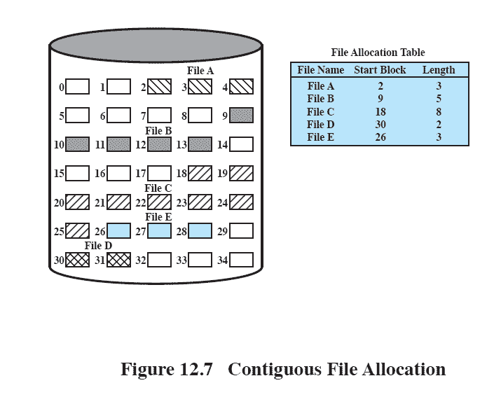
Contiguous File Allocation
A single contiguous set of blocks is allocated to a file at the time of file creation
Preallocation strategy using variable-size portions
Is the best from the point of view of the individual sequential file
12.9
Notes:
With contiguous allocation , a single contiguous set of blocks is allocated to a
file at the time of file creation ( Figure 12.9 ). Thus, this is a preallocation strategy,
using variable-size portions. The file allocation table needs just a single entry for
each file, showing the starting block and the length of the file. Contiguous allocation
is the best from the point of view of the individual sequential file. Multiple blocks
can be read in at a time to improve I/O performance for sequential processing. It is
also easy to retrieve a single block. For example, if a file starts at block b , and the
i th block of the file is wanted, its location on secondary storage is simply b + i – 1.
Contiguous allocation presents some problems. External fragmentation will occur,
making it difficult to find contiguous blocks of space of sufficient length.

Slide 11
Disadvantage
External fragmentation will occur, making it difficult to find contiguous blocks of space of sufficient length. Compaction algorithm will be necessary to free up additional space on disk.
Also, with pre-allocation, it is necessary to declare the size of the file at the time of creation.

Slide 12
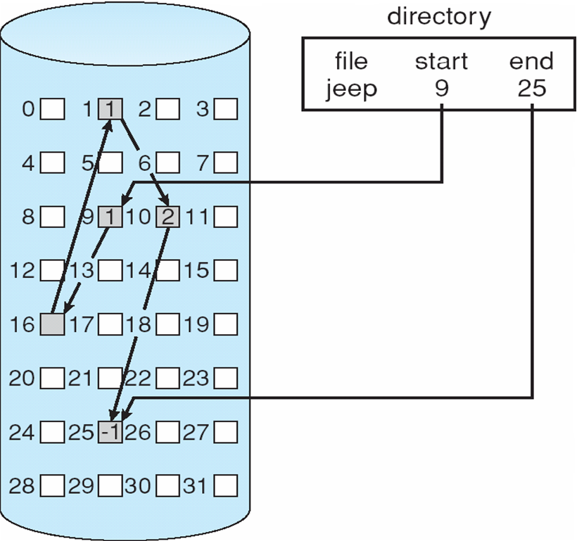
Linked Allocation (chained)
Allocation is on an individual block basis
Each block contains a pointer to the next block in the chain
The file allocation table needs just a single entry for each file
No external fragmentation to worry about
Better for sequential files

Slide 13
Disadvantage:
Internal fragmentation exists in last disk block of file.
There is an overhead of maintaining the pointer in every disk block.
If the pointer of any disk block is lost, the file will be truncated.
It supports only the sequencial access of files.

Slide 14
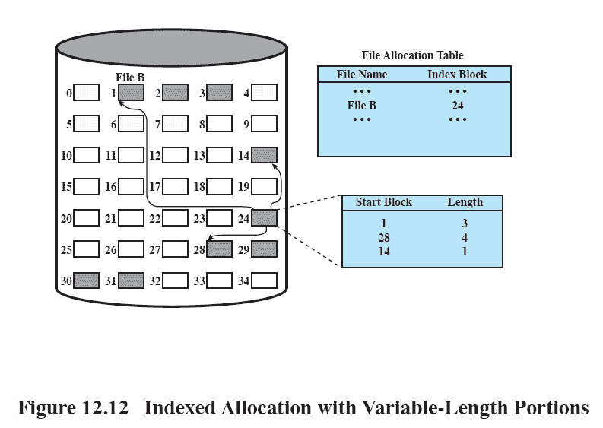
Indexed Allocation with Variable Length Portions
12.14
Notes:
Figure 12.14 Indexed allocation with Variable-Length Portions

Slide 15
Free-Space Management
Thus we need a disk allocation table in addition to a file allocation table.The following are the approaches used for free space management.
Bit Tables :
Free Block List :

Slide 16
Free-Space Management
File system maintains free-space list to track available blocks/clusters
(Using term “block” for simplicity)
Bit vector or bit map (n blocks)
0
1
2
n-1
…

1 ⇒ block[i] free
0 ⇒ block[i] occupied
bit[i] =
Block number calculation
(number of bits per word) *
(number of 0-value words) +
offset of first 1 bit
CPUs have instructions to return offset within word of first “1” bit

Slide 17
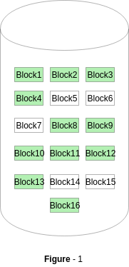
A Bitmap or Bit Vector is series or collection of bits where each bit corresponds to a disk block. The bit can take two values: 0 and 1: 0 indicates that the block is allocated and 1 indicates a free block.
The given instance of disk blocks on the disk in Figure 1 (where green blocks are allocated) can be represented by a bitmap of 16 bits as: 0000111000000110.

Slide 18
Free-Space Management (Cont.)
Bit map requires extra space
Example:
block size = 4KB = 2¹² bytes
disk size = 2⁴⁰ bytes (1 terabyte)
n = 2⁴⁰/2¹² = 2²⁸ bits (or 256 MB)
if clusters of 4 blocks -> 64MB of memory
Easy to get contiguous files
Linked list (free list)
Cannot get contiguous space easily
No waste of space
No need to traverse the entire list (if # free blocks recorded)

Slide 19
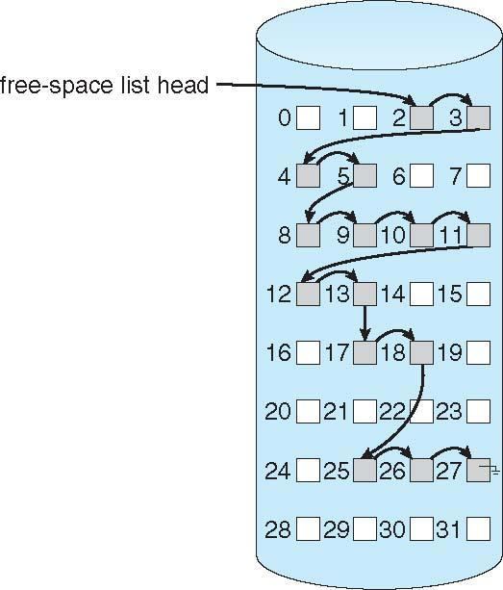
Linked Free Space List on Disk

Slide 20
3 Grouping – This approach stores the address of the free blocks in the first free block. The first free block stores the address of some, say n free blocks. Out of these n blocks, the first n-1 blocks are actually free and the last block contains the address of next free n blocks. An advantage of this approach is that the addresses of a group of free disk blocks can be found easily.

Slide 21
Thankyou

